Slide 1
Intro to SuzieQ
James Harr, Sr DevOps NetEng, Internet2
2024-12-11

Slide 2
What can it do?
Architecture
  Poller and Coalescer
  GUI and API
  Inventory Source
Common Tasks
  What's available
  Looking up basic information
  Path finding
  What changed?
  Assertions
OSS vs Enterprise
Intro to SuzieQ

Slide 3
What can SuzieQ do?

Slide 4
What can SuzieQ do?
Provides a network-wide view of operational data
View changes over time
  What was it like at X time?
  What changed?
Validate configuration (assertions)
  Are all my configured BGP neighbors up?
  Are there any MTU mismatches on any links?

Slide 5
SuzieQ Architecture

Slide 6
SuzieQ Architecture
Poller
  Reads Config & Inventory
  Polls devices (CLI or API)
  Stores data in DB (Parquet)
Coalescer
  Consolidates data that's consistent between polls
API, CLI, GUI
  Clients can analyze data
API
GUI
CLI
Parquet Datastore
Network Devices
Poller
Poller(s)
Coalescer
Poller
Device Inventory

Slide 7
SuzieQ Datastore
Datastore
Uses Pandas and Parquet (OSS) as a backend
Supports multiple writers (Pollers)
Tracks data over-time

Slide 8
SuzieQ Poller
Supported Platforms:
Arista EOS
Cisco IOS / IOS-XE
Cisco IOS-XR
Cisco NX-OS
Cumulus Linux
Juniper JunOS
Linux
PaloAlto PANOS
SONIC
Inventory Sources:
File
Ansible Inventory
Netbox
  Probably Nautobot too
Source:
https://suzieq.readthedocs.io/en/latest/tables/ - Device Support
https://suzieq.readthedocs.io/en/latest/inventory/ - Inventory file formats & inputs

Slide 9
SuzieQ Coalescer
Consolidates Data that's the same
  "This interface up at 08:00, 08:10, 08:20, 08:30, down at 08:40 and 08:50"
  Coalesced data: "interface up at 08:00-08:30, down at 08:40-08:50"
Allows poller to focus on "get a snapshot, save it to disk"
Coalesced data is smaller on disk and is faster to query
All the clients are smart enough to deal with both

Slide 10
SuzieQ Clients
All clients have similar access to the data
Pandas-style query language available
Client types:
Basic WebUI (based on StreamLit)
Rest API
CLI
  Has an additional simplified query expression
  Can directly access data on-disk or be pointed to a Rest API

Slide 11
Common Tasks

Slide 12
Common Tasks - What information is available?
Forwarding Information / End Host information:
  MAC Forwarding Tables
  ARP/ND tables
  Routing Tables
Topology information
  BGP Neighbors
  OSPF Neighbors
  LLDP Neighbors
  EVPN VTEPs
Device Information
  OS Information
  Hardware Inventory

Slide 13
Common Tasks - MAC Table
suzieq> mac show
namespace hostname vlan macaddr oif remoteVtepIp bd flags
0 i2-smn smn-rtsw1.albu 100 00:0a:9c:12:29:03 ge-0/0/0
1 i2-smn smn-rtsw1.albu 100 00:13:c6:08:02:e6 ge-0/0/1
2 i2-smn smn-rtsw1.albu 300 c8:ca:79:96:59:cf ge-0/0/12
3 i2-smn smn-rtsw1.albu 300 d4:b7:d0:4e:70:50 xe-0/0/19
4 i2-smn smn-rtsw1.cinc 100 00:0a:9c:12:25:95 ge-0/0/5
5 i2-smn smn-rtsw1.cinc 100 00:0a:9c:63:5d:25 ge-0/0/0
6 i2-smn smn-rtsw1.cinc 100 00:13:c6:08:2c:1b ge-0/0/1
7 i2-smn smn-rtsw1.cinc 200 2c:ea:7f:f2:a2:30 ge-0/0/6
8 i2-smn smn-rtsw1.cinc 200 2c:ea:7f:f2:a2:36 ge-0/0/7
9 i2-smn smn-rtsw1.cinc 100 08:4f:a9:5c:fb:0b ge-0/0/2
...

Slide 14
Common Tasks - MAC Table Changes
suzieq> mac show macaddr="20:80:58:de:e4:80" start-time="3d ago" end-time="now"
columns="active hostname vlan macaddr oif timestamp"
active hostname vlan macaddr oif timestamp
0 - smn-rtsw1.seat 300 20:80:58:de:e4:80 ge-0/0/11 2024-12-06 09:20:23.809000+00:00
1 + smn-rtsw1.seat 300 20:80:58:de:e4:80 ge-0/0/11 2024-12-06 10:37:07.170000+00:00
2 - smn-rtsw1.seat 300 20:80:58:de:e4:80 ge-0/0/11 2024-12-06 17:02:33.487000+00:00
3 + smn-rtsw1.seat 300 20:80:58:de:e4:80 ge-0/0/11 2024-12-08 01:13:30.468000+00:00
4 - smn-rtsw1.seat 300 20:80:58:de:e4:80 ge-0/0/11 2024-12-08 02:35:33.421000+00:00
5 + smn-rtsw1.seat 300 20:80:58:de:e4:80 ge-0/0/11 2024-12-08 03:37:20.616000+00:00
6 - smn-rtsw1.seat 300 20:80:58:de:e4:80 ge-0/0/11 2024-12-08 04:59:44.151000+00:00
7 + smn-rtsw1.seat 300 20:80:58:de:e4:80 ge-0/0/11 2024-12-08 06:04:06.148000+00:00
8 - smn-rtsw1.seat 300 20:80:58:de:e4:80 ge-0/0/11 2024-12-08 07:26:21.510000+00:00
9 + smn-rtsw1.seat 300 20:80:58:de:e4:80 ge-0/0/11 2024-12-08 15:00:10.295000+00:00
10 - smn-rtsw1.seat 300 20:80:58:de:e4:80 ge-0/0/11 2024-12-08 16:18:23.141000+00:00
11 + smn-rtsw1.seat 300 20:80:58:de:e4:80 ge-0/0/11 2024-12-08 20:38:21.556000+00:00
12 - smn-rtsw1.seat 300 20:80:58:de:e4:80 ge-0/0/11 2024-12-08 22:04:16.427000+00:00

Slide 15
How SuzieQ deals with time
View Point-in-Time
view=latest → (default) Show current state
end-time="24h ago" → What it looked like 24hr ago
end-time="2024-12-02 17:00" → Similar thing w/ absolute time
View Changes
view=all
start-time="1d ago"
start-time="4h ago" end-time="3h ago"

Slide 16
Common Tasks - ARP/ND Lookup
suzieq> arpnd show hostname="smn-rtsw1.sanj"
columns="hostname ipAddress oif macaddr state"
hostname ipAddress oif macaddr state
0 smn-rtsw1.sanj 162.244.108.18 irb.300 18:92:a4:34:cc:10 reachable
1 smn-rtsw1.sanj 163.253.9.190 ge-0/0/13.2079 1c:9c:8c:6f:63:0d reachable
2 smn-rtsw1.sanj 163.253.10.237 xe-0/0/20.3268 1c:9c:8c:6f:63:17 reachable
3 smn-rtsw1.sanj 163.253.10.239 xe-0/0/21.3269 1c:9c:8c:6f:63:18 reachable
4 smn-rtsw1.sanj 163.253.13.154 irb.100 00:13:c6:08:0d:5d reachable
5 smn-rtsw1.sanj 163.253.13.155 irb.100 00:0a:9c:63:7c:18 reachable
6 smn-rtsw1.sanj 163.253.13.156 irb.100 68:3b:78:52:f4:38 reachable
7 smn-rtsw1.sanj 163.253.13.157 irb.100 70:b3:17:33:ba:18 reachable
8 smn-rtsw1.sanj 163.253.13.158 irb.100 00:0a:9c:12:29:26 reachable
9 smn-rtsw1.sanj 163.253.13.250 irb.100 4c:71:0d:93:af:2e reachable
10 smn-rtsw1.sanj 163.253.13.251 irb.100 2c:01:b5:0a:6e:76 reachable
11 smn-rtsw1.sanj 163.253.15.90 irb.200 2c:ea:7f:f5:bb:80 reachable
12 smn-rtsw1.sanj 163.253.15.91 irb.200 2c:ea:7f:f5:bb:86 reachable
13 smn-rtsw1.sanj 192.168.1.1 em2.32768 1c:9c:8c:6f:3b:03 reachable

Slide 17
Common Tasks - BGP Health Checks (assertions)
suzieq> bgp assert
namespace hostname vrf peer asn peerAsn state peerHostname result assertReason
0 i2-smn smn-rtsw1.jack default 163.253.9.1 64600 64600 Established pass -
1 i2-smn smn-rtsw1.jack default 163.253.9.2 64600 64600 Established pass -
2 i2-smn smn-rtsw1.jack default 163.253.9.3 64600 64600 Established pass -
3 i2-smn smn-rtsw1.jack default 163.253.9.4 64600 64600 Established pass -
4 i2-smn smn-rtsw1.jack default 163.253.9.5 64600 64600 Established pass -
5 i2-smn smn-rtsw1.jack default 163.253.9.6 64600 64600 Established pass -
6 i2-smn smn-rtsw1.jack default 163.253.9.7 64600 64600 Established pass -
7 i2-smn smn-rtsw1.jack default 163.253.9.8 64600 64600 Established pass -
8 i2-smn smn-rtsw1.jack default 163.253.9.9 64600 64600 Established pass -
...
Assert passed

Slide 18
Common Tasks - BGP Health Checks (assertions)
suzieq> bgp assert end-time="8h ago" result=fail
columns="hostname peer asn peerAsn result assertReason"
hostname peer asn peerAsn result assertReason
0 smn-rtsw1.chic 163.253.9.72 64600 64602 fail Not all Afi/Safis enabled
1 smn-rtsw1.chic 163.253.9.74 64600 64602 fail Not all Afi/Safis enabled
2 smn-rtsw1.chic 163.253.9.76 64600 64602 fail Not all Afi/Safis enabled
3 smn-rtsw1.chic 163.253.9.78 64600 64602 fail Not all Afi/Safis enabled
4 smn-rtsw1.chic 163.253.9.100 64600 64602 fail Not all Afi/Safis enabled
5 smn-rtsw1.salt 163.253.9.90 64600 64604 fail Not all Afi/Safis enabled
6 smn-rtsw1.salt 163.253.9.92 64600 64604 fail Not all Afi/Safis enabled
7 smn-rtsw1.salt 163.253.9.94 64600 64604 fail Not all Afi/Safis enabled
8 smn-rtsw1.salt 163.253.9.96 64600 64604 fail Not all Afi/Safis enabled
9 smn-rtsw2.salt 163.253.9.106 64600 64604 fail Not all Afi/Safis enabled
10 smn-rtsw2.salt 163.253.9.108 64600 64604 fail Not all Afi/Safis enabled
11 smn-rtsw2.salt 163.253.9.110 64600 64604 fail Not all Afi/Safis enabled
12 smn-rtsw2.salt 163.253.9.112 64600 64604 fail Not all Afi/Safis enabled
13 smn-rtsw2.salt 163.253.9.114 64600 64604 fail Not all Afi/Safis enabled

Slide 19
Common Tasks - Path Trace
suzieq> path show src="163.253.9.42" dest="163.253.9.50" namespace=i2-smn
pathid hopCount hostname iif oif inMtu
1 0 smn-rtsw1.sacr lo0.0 xe-0/0/20.3237 65536
1 1 smn-rtsw1.reno xe-0/0/20.3237 xe-0/0/20.3238 9158
1 2 smn-rtsw1.salt xe-0/0/20.3238 xe-0/0/17.3079 9158
1 3 smn-rtsw1.denv xe-0/0/16.3079 xe-0/0/17.3079 9158
1 4 smn-rtsw1.elpa xe-0/0/18.3079 lo0.0 9158
2 0 smn-rtsw1.sacr lo0.0 xe-0/0/21.3270 65536
2 1 smn-rtsw1.sunn xe-0/0/21.3270 xe-0/0/19.3079 9158
2 2 smn-rtsw1.salt xe-0/0/22.3079 xe-0/0/17.3079 9158
2 3 smn-rtsw1.denv xe-0/0/16.3079 xe-0/0/17.3079 9158
2 4 smn-rtsw1.elpa xe-0/0/18.3079 lo0.0 9158
... more ECMP paths
Notes:
Not exactly traceroute
- Shows every path any individual packet might take. Even if you have

Slide 20
Common Tasks - Path Trace
R1
R3
X
Source
Destination
R2
R4
Notes:
Not exactly traceroute
- Shows every path any individual packet might take. Even if you have

Slide 21
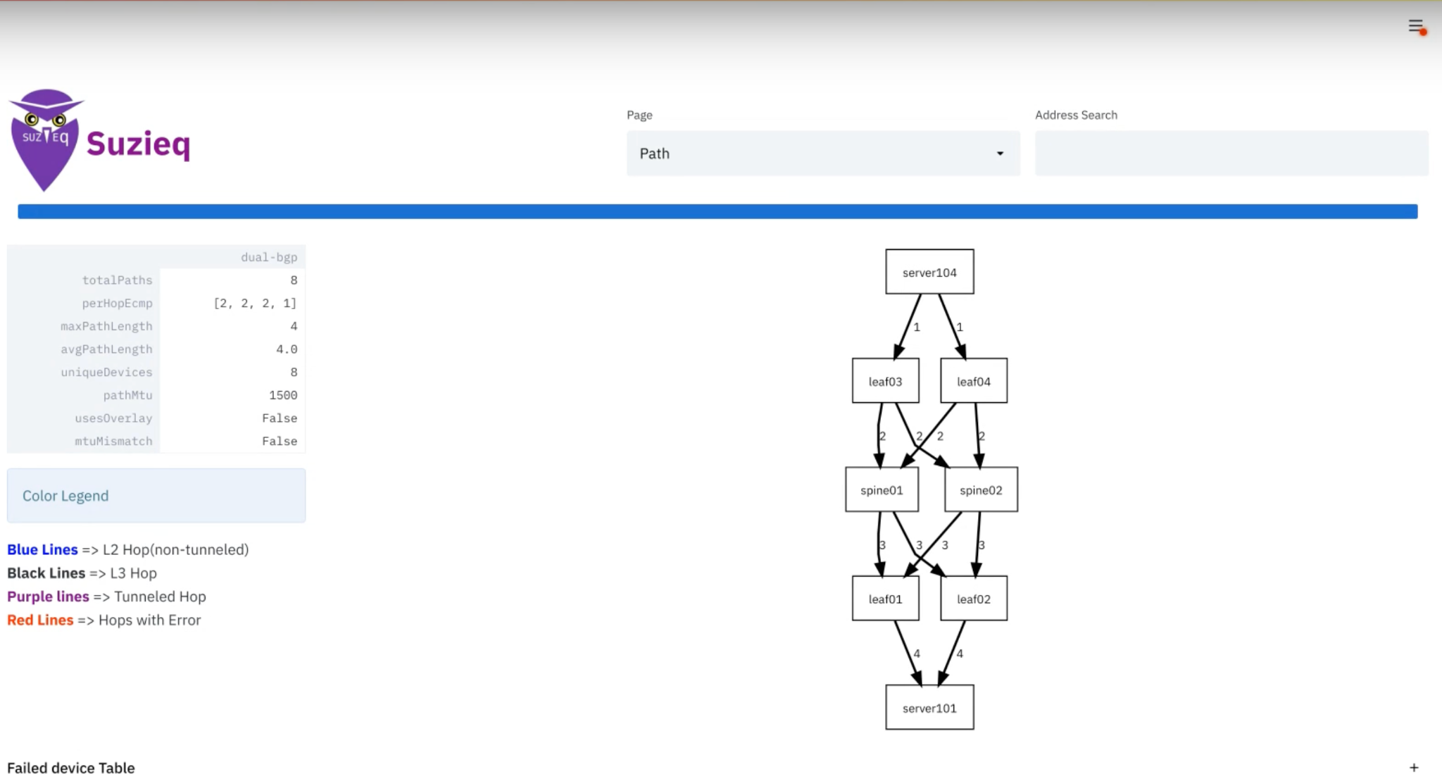
Common Tasks - Path Trace (GUI)

Slide 22
OSS vs Enterprise

Slide 23
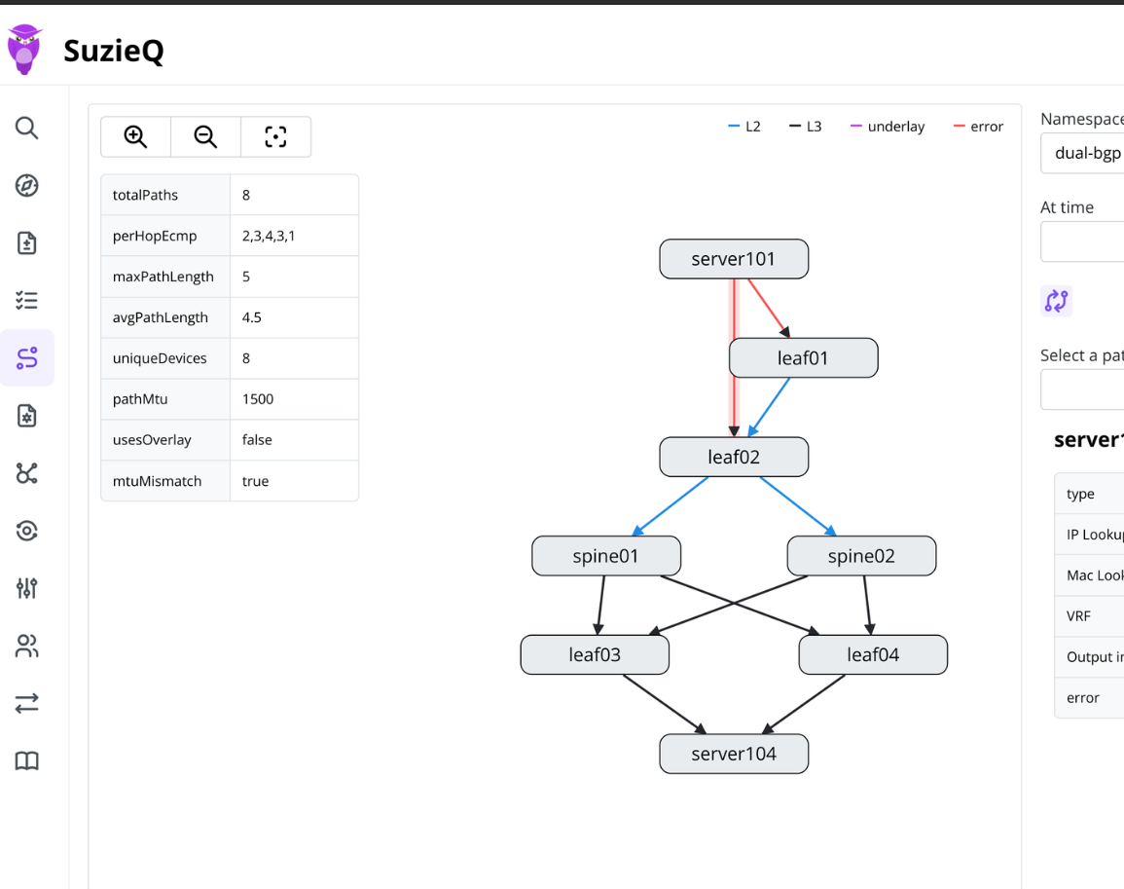
SuzieQ OSS vs Enterprise
SuzieQ Enterprise
SSO and RBAC
Different UI
  Topology display
  Click-to-view Interface Config
  ... lots more features
Faster
  Better storage backend
  Faster Pollers
Correlate with external data
  IPAM, Orchestration, Spreadsheets
Custom Assertions
Support & Developer Credits

Slide 24
Thank You / Q&A

