Slide 1
From Automation to Autonomous Networks with AI
Maria Isabel Gandía Carriedo, CSUC/RedIRIS,
Network eAcademy Service Manager & GN5-1 WP6T4 Lead
Internet2 Technology Exchange, Boston
11 December 2024

Slide 2
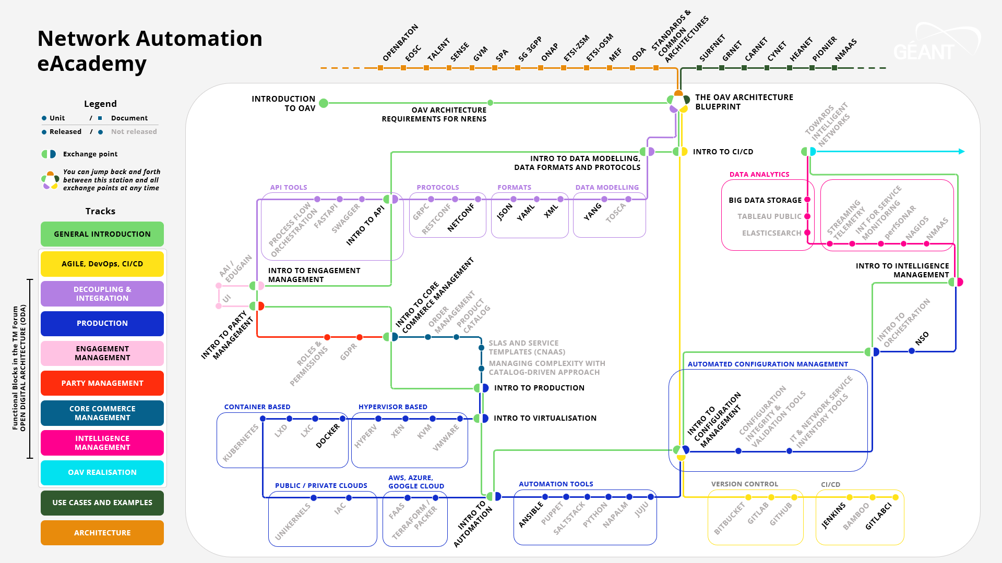
https://wiki.geant.org/display/NETDEV/OAV+Training+Portal
December 2022
CC BY-NC-SA, free access through eduGAIN or Social Media
Notes:
To make it easier to follow, we created an interactive metro map with the help of the Marcomms team in GÉANT, where each knowledege block is a line. So, you can follow the general introductory line, or more in-depth units, differenciated by colours and also following the functional blocks in ODA. There are round stations, that correspond to Moodle courses in the GÉANT Learning and Development platform, with presentations, videos with subtitles and quizzes, and square stations, that are links to documents and external resources.

Slide 3
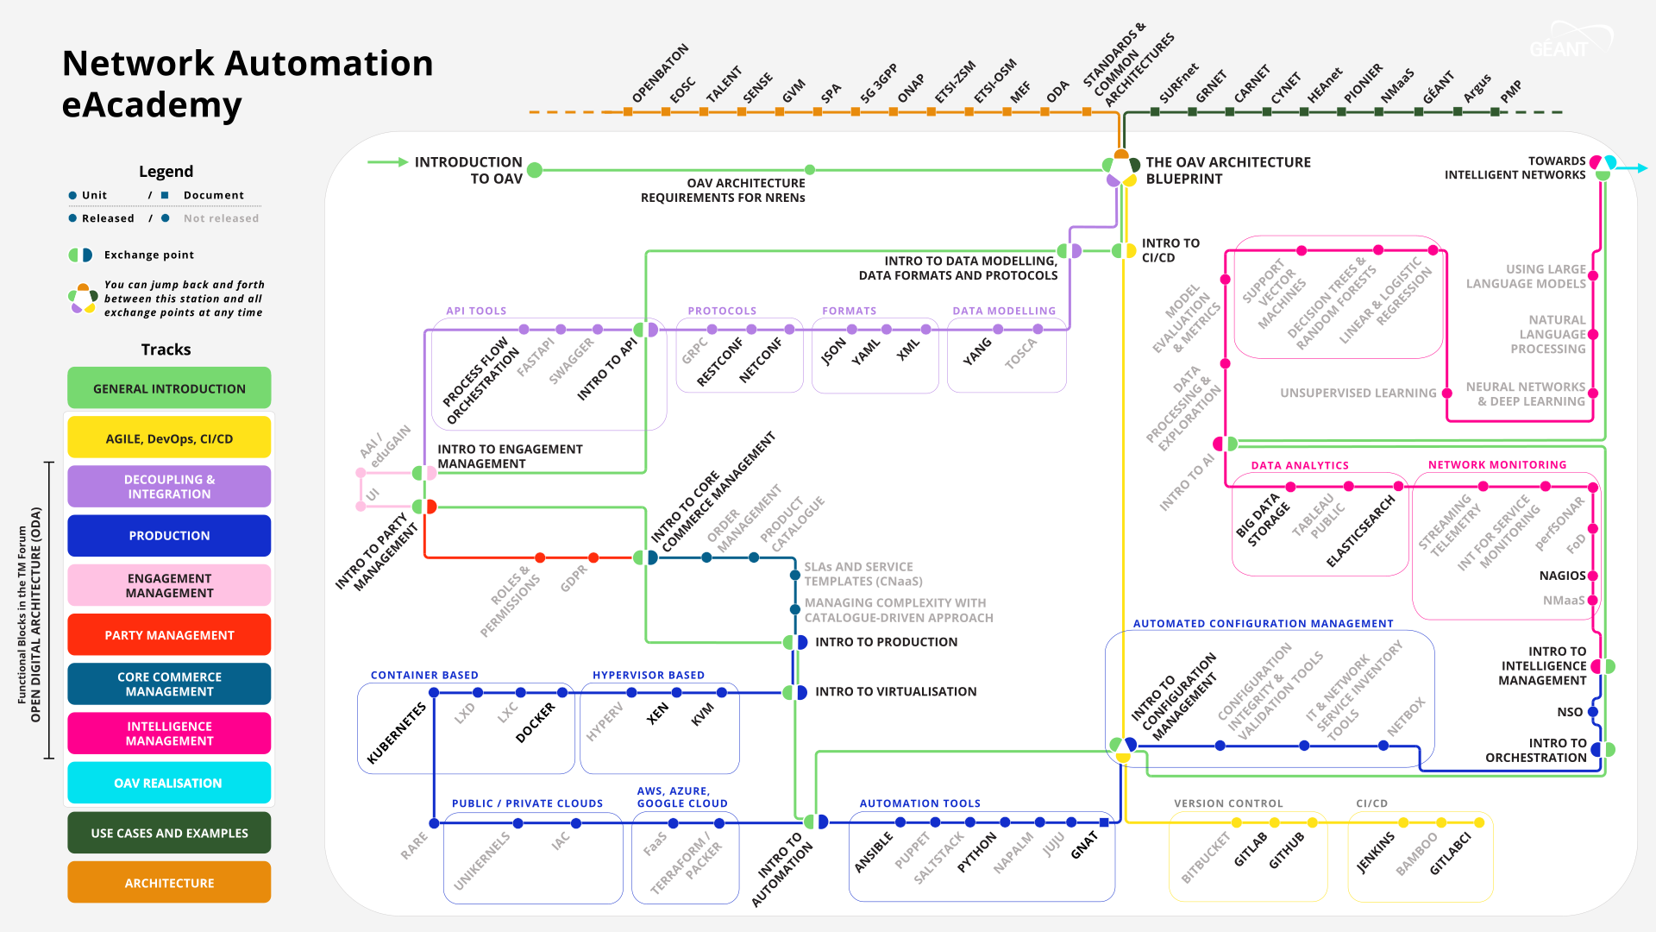
https://wiki.geant.org/display/NETDEV/Network+Automation+Training
December 2024
New AI section
CC BY-NC-SA, free access through eduGAIN or Social Media

Slide 4
Benefits of Automation...
Faster service delivery
Reduce the number of human errors
Decrease the amount of manual work
Lower the costs of service delivery
Ensure configuration consistency
Provide better reporting
Increase efficiency

Slide 5
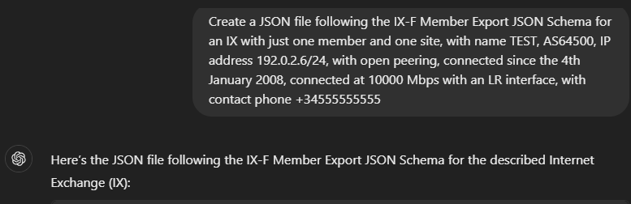
Artificial Intelligence
{
"version": "0.6",
"member_list": [
{
"asnum": 64500,
"member_type": "peering",
"connection_list": [
{
"ixp_id": 1,
"state": "connected",
"if_list": [
{
"if_speed": 10000,
"if_type": "LR",
"mac_addresses": []
}
],
"ipv4": [
"192.0.2.6/24"
],
"ipv6": []
}
],
"policy": {
"general": "open"
},
"contact_email": [],
"contact_phone": [
"+34555555555"
],
"provisioning_since": "2008-01-04"
}
],
"ixp_list": [
{
"ixp_id": 1,
"shortname": "TEST",
"name": "TEST Internet Exchange",
"url": null
}
]
}
Tools like ChatGPT, Microsoft Copilot, Google’s Gemini, etc, already can help us automating (answers are close to correct ;-) ).
Datasets, models and community (for instance, https://huggingface.co/).
Create a JSON file following the IX-F Member Export JSON Schema for an IX with just one member and one site, with name TEST, AS64500, IP address 192.0.2.6/24, with open peering, connected since the 4th January 2008, connected at 10000 Mbps with an LR interface, with contact phone +34555555555

Slide 6
Artificial Intelligence... There’s More!
Support decision making and planning infrastructure.
Predicting and improving performance.
Predict and proactively prevent outages (self-healing).
Self-organising network solutions.
Virtual agents (chatbots).

Slide 7
Network Operations and Management with AI
SELF
ZERO

Slide 8
Network Operations and Management with AI
SELF
Self-service
Self-fulfilling
Self-assuring
Self- planning
Self-ordering
Self-organising
Self-governing
Self-healing / Self-repairing
Self-optimising
ZERO
Zero-wait
Zero-touch
Zero-trouble
Zero-downtime
Zero-trust
Examples of closed-loop anomaly detection (Traffic Flow Optimization , Security violations, Performance Prediction, Alert Correlation, etc):
https://www.tmforum.org/resources/introductory-guide/ig1219-ai-closed-loop-automation-anomaly-detection-and-resolution-v2-1-0/

Slide 9
Automation – Processing tasks in a repeatable manner to yield the same result every time without human intervention.
Autonomous Networks - A set of network and software platforms that can sense their environment and adapt their behaviour accordingly with little or no human input.

Slide 10
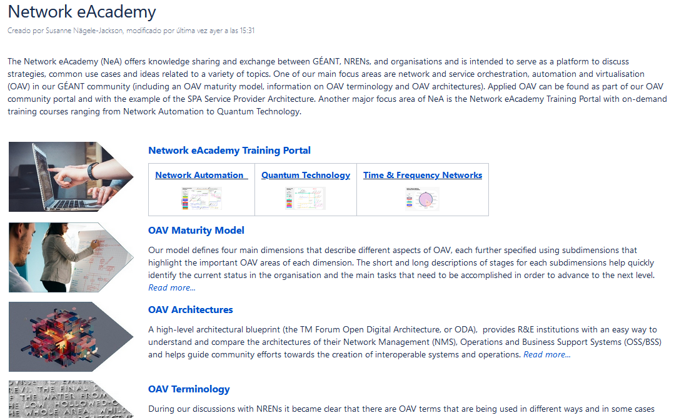
More info on the Network eAcademy
https://wiki.geant.org/display/NETDEV/Network+eAcademy

Slide 11
Thank you!
netdev@lists.geant.org

