Slide 1
Automation
TechEx22

Slide 2
Network Automation
Are We There Yet?
Notes:
I’m Will Whitaker, with the core networking team at UNC. I am part of the network architecture team and have a primary role in several of our campus services, but I also lead a DEVOPS group.
When people say DEVOPS, they are usually talking about DEVOPS with a heavy focus on DEV. I think of our team as more of DEVOPS significant origins on the OPS side instead. We’ve been active since 2019 and this talk will hit on our origin story.

Slide 3
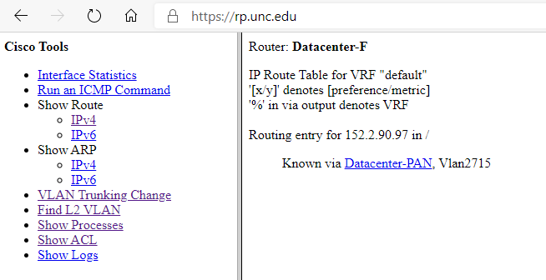
The Catalyst
Notes:
Like most organizations, we have a lot of tooling. It is mixed with vendor tools, off-the-shelf products, and in-house development. While the core networking team has one staff developer, it is common for coding to take place individually when a technology expert must solve a problem in their own wheelhouse. That builds technical debt and sets up our catalyst.
In 2018, a change in personnel left a gap in support for a somewhat essential tool called RouterProxy. It had grown over many years in functionality since it had the goal of making life easier for our network and security administrators. After the staff change, it proved to be a significant challenge to maintain and extend further. This opened the door for a new approach, one that would address the shortcomings of the prior setup.
Team of mixed skill and focus areas
Team makeup:
1 dedicated developer on staff
Everyone else has a day job
Membership across organization

Slide 4
The Goals
Maintain essential functionality
  Who are the users? What do they really need?
Use a team approach
  Spread skills over multiple people, avoid skill silos
  Extend opportunity to other ITS departments
  Grow expertise among members
Embrace new development and deployment patterns
  Set up for future growth
Consider security and plan appropriately
Notes:
Maintainable solution
Ability to grow
Security, how to securely deploy with current device access models

Slide 5
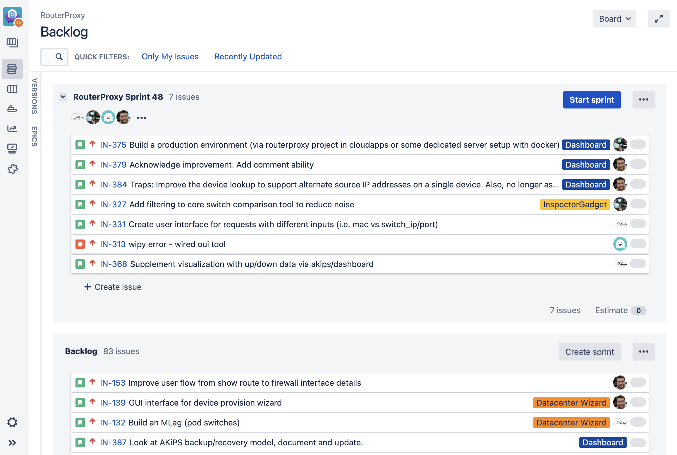
Agile Development and SCRUM
Backlog Management
Jira Scrum Board
Sprint Planning
Task Tracking
Product Owners
Notes:
Before we talk about specific tool stacks, we need to do some basic organizational work.
2 week sprints

Slide 6
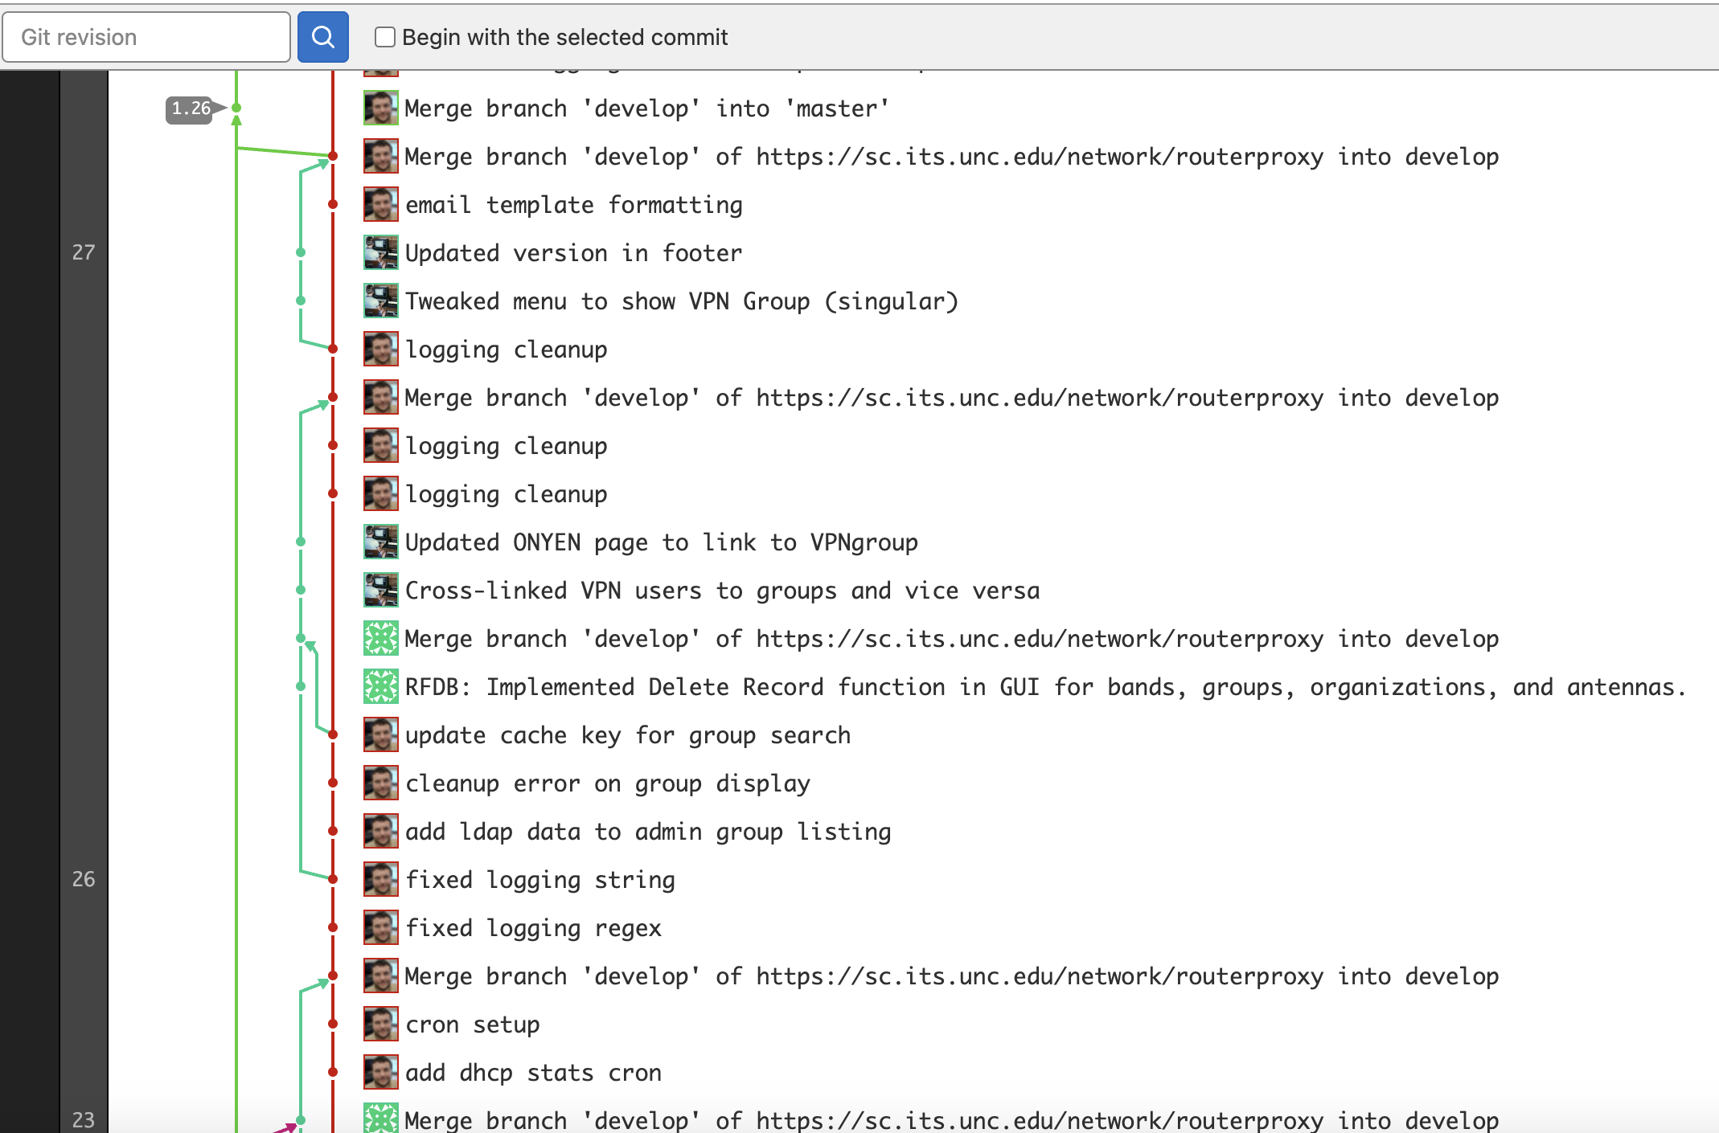
GitLab
Source Code Management
Git basics
Branch planning
Coding conventions
Pipeline Automation

Slide 7



The Framework
Django / Python
- Dynamic Content
- Function API
HTML/CSS
REST API
AJAX
Device SSH
Netmiko
Service APIs

Slide 8
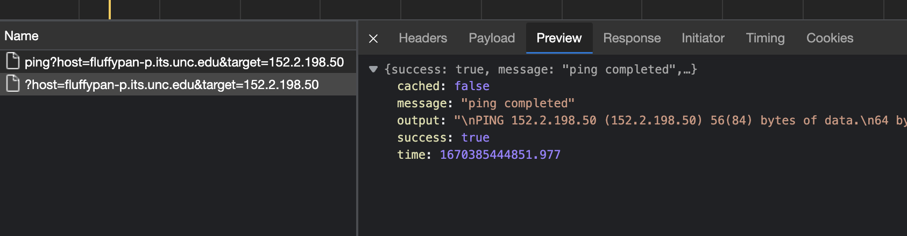
API Planning
Standardized requests and responses calls for operations interacting with other devices and APIs.

Slide 9
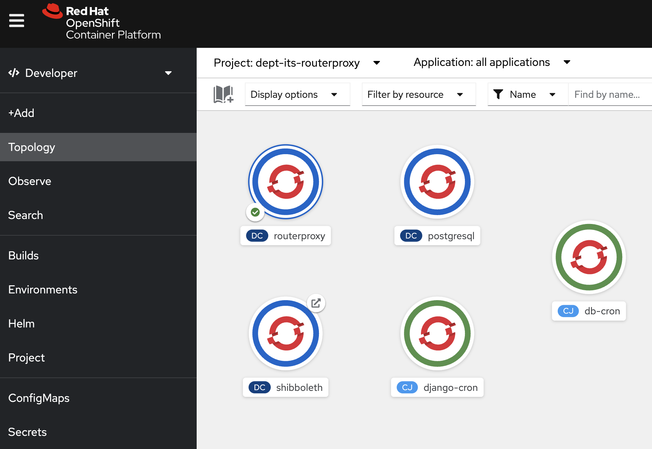
Platform As A Service
OpenShift (Cloudapps)
Established campus offering
Project layout
  Production
  Testing
Triggered builds
Notes:
OpenShift is a family of containerization software products developed by Red Hat. Its flagship product is the OpenShift Container Platform — a hybrid cloud platform as a service built around Linux containers orchestrated and managed by Kubernetes on a foundation of Red Hat Enterprise Linux.

Slide 10
Feature Areas
Core
IPAM
VPN Tools
VoIP Tools
Wireless Tools
RF Spectrum DB
ping, arp, traceroute, vlan, interfaces, ACLs, block reporting
Interface with Infoblox data, automate add/update/deletes
AnyConnect client and group details, statistics
Automated porting between VoIP providers
AP management, bulk controller changes, reporting
RF usage, placement, ownership, mapping

Slide 11
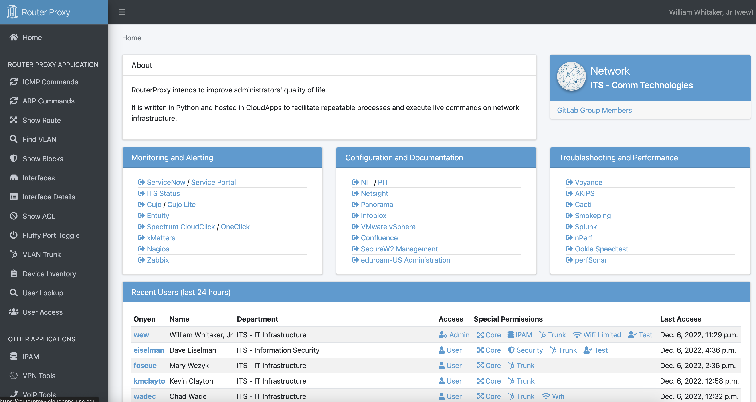
Demonstration

Slide 12
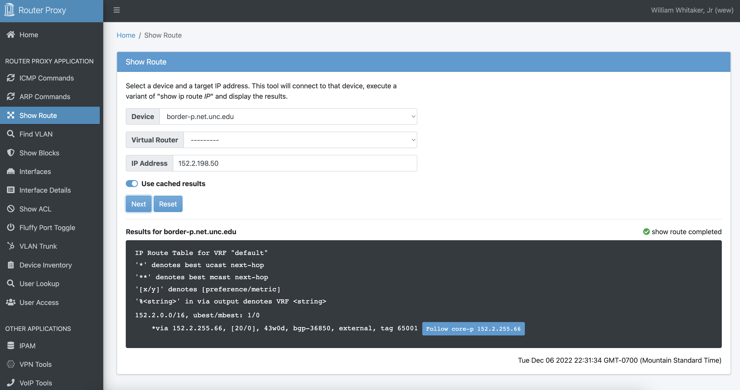
Demonstration

