Slide 1
  Network Automation with Ansible
Frank Seesink
v1.0
Notes:
The greatest gift is that of time. This is my attempt to give you back some of yours.

Slide 2
History of Network Management
SNMP
    “Simple” Network Management Protocol
Oh, and “screen scraping”

Slide 3
DevOps

Slide 4
What is this DevOps of which you speak?
“DevOps (a clipped compound of "development" and "operations") is a software engineering practice that aims at unifying software development (Dev) and software operation (Ops).”
Source: https://en.wikipedia.org/wiki/DevOps

Slide 5
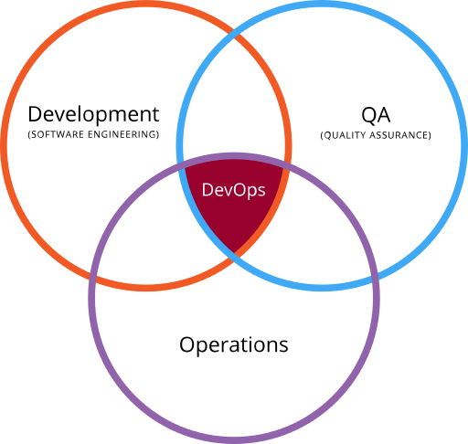

Slide 6
In Plain English?
The love child between systems/network administrators and programmers

Slide 7
Configuration Management Tools

Slide 8








Slide 9




Slide 10
So Why Ansible?

Slide 11
Ansible
The name "Ansible" references a fictional instantaneous hyperspace communication system (as featured in Orson Scott Card's Ender's Game (1985),[9][10] and originally conceived by Ursula K. Le Guin for her novel Rocannon's World (1966)).[11]
Source: https://en.wikipedia.org/wiki/Ansible_(software)

Slide 12
Agent-based vs. Agent-less*
  CFEngine
  Chef
  Munki
  Puppet
  SaltStack
  Ansible

Slide 13


Agent-based
Client
Server
Client
Client
Notes:
Terms:
Server == Puppet Master, Salt Master, etc.
Client== Puppet Agent, Salt Minion, etc.
Configuration files == (Puppet) catalog, Salt States (SLS), etc.
Also have terms like grains, pillars, etc. for Salt, for example.
Typically agents check-in every so often—default for Puppet is every 15 minutes, for Munki is once every 4 hours—to make sure they are up-to-date.

Slide 14
Agent-less
Client
Server
Client
Client

Slide 15
Advantages of
Agent-based
Client
Server
Client
Client

Slide 16
Advantages of
Agent-based
Client
Server
Client
Client
Notes:
Typically agents check in, thus coming out through any firewalls vs. the server trying to come in. Of course, in a tightly regulated environment with proxy servers, etc., this may require additional work, but often things “just work.”

Slide 17

Advantages of
Agent-based
Client
Persistent bus connection
Server
Client
Client
Notes:
Salt Stack is different from other agent-based configuration management tools in that it creates a persistent connection back to the minions. This allows for immediate execution of commands.
For example, you get a call that some of your users are experiencing issues getting to Google. With Salt, you could tell all of your minions to ping Google’s servers and to report back. This gives you insight from across your network (and also gives you a kind of botnet of your very own!).

Slide 18

Advantages of
Agent-less
Client
SSH
Server
Client
Client

Slide 19


Agent-less
*
Client
Server
Client
Client
for clients which support Python,
agent script sent through SSH
tunnel to run on far end

Slide 20
Ansible 2.x
(currently v2.4)
SSH
raw module
network modules
e.g., Ios, Junos, etc.
Server

Slide 21
Network Modules
A10
ACI (Cisco)
Aireos (Cisco)
Aos
Aruba
Asa (Cisco)
Avi
Bigswitch
Citrix
Cloudengine
Cloudvision (Arista)
Cumulus
Dellos10
Dellos6
Dellos9
Eos (Arista)
F5
Fortios
Illumos
Interface
Ios (Cisco)
Iosxr (Cisco)
Junos
Layer2
Layer3
Lenovo
Netconf
Netscaler
Netvisor
Nuage
Nxos (Cisco)
Ordnance
Ovs
Panos
Protocol
Radware
Routing
Sros
System
Vyos
Source: http://docs.ansible.com/ansible/latest/list_of_network_modules.html

Slide 22
Network Modules (cont.)
Cisco IOS
Ios
  ios_banner - Manage multiline banners on Cisco IOS devices
  ios_command - Run commands on remote devices running Cisco IOS
  ios_config - Manage Cisco IOS configuration sections
  ios_facts - Collect facts from remote devices running Cisco IOS
  ios_interface - Manage Interface on Cisco IOS network devices
  ios_logging - Manage logging on network devices
  ios_ping - Tests reachability using ping from IOS switch
  ios_static_route - Manage static IP routes on Cisco IOS network devices
  ios_system - Manage the system attributes on Cisco IOS devices
  ios_user - Manage the aggregate of local users on Cisco IOS device
  ios_vrf - Manage the collection of VRF definitions on Cisco IOS devices
Source: http://docs.ansible.com/ansible/latest/list_of_network_modules.html

Slide 23
I am NOT idempotent!
Wait… what?

Slide 24
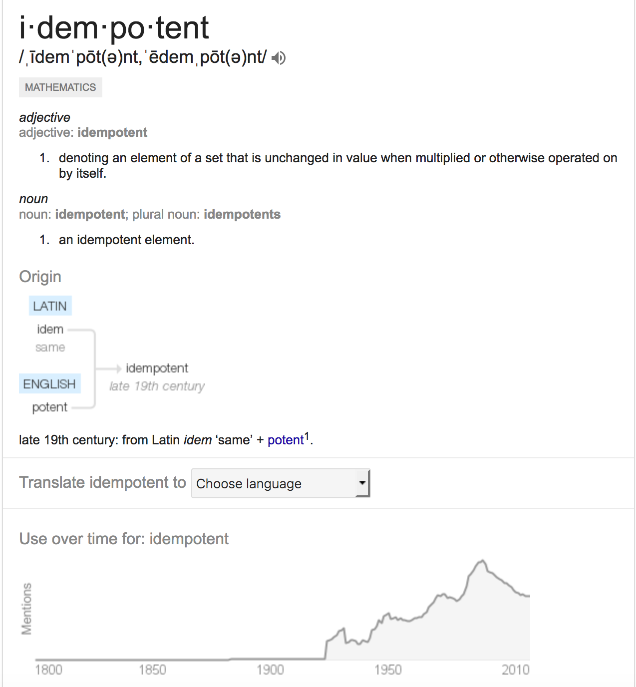
Idempotent
Source: “The Google”

Slide 25


Slide 26
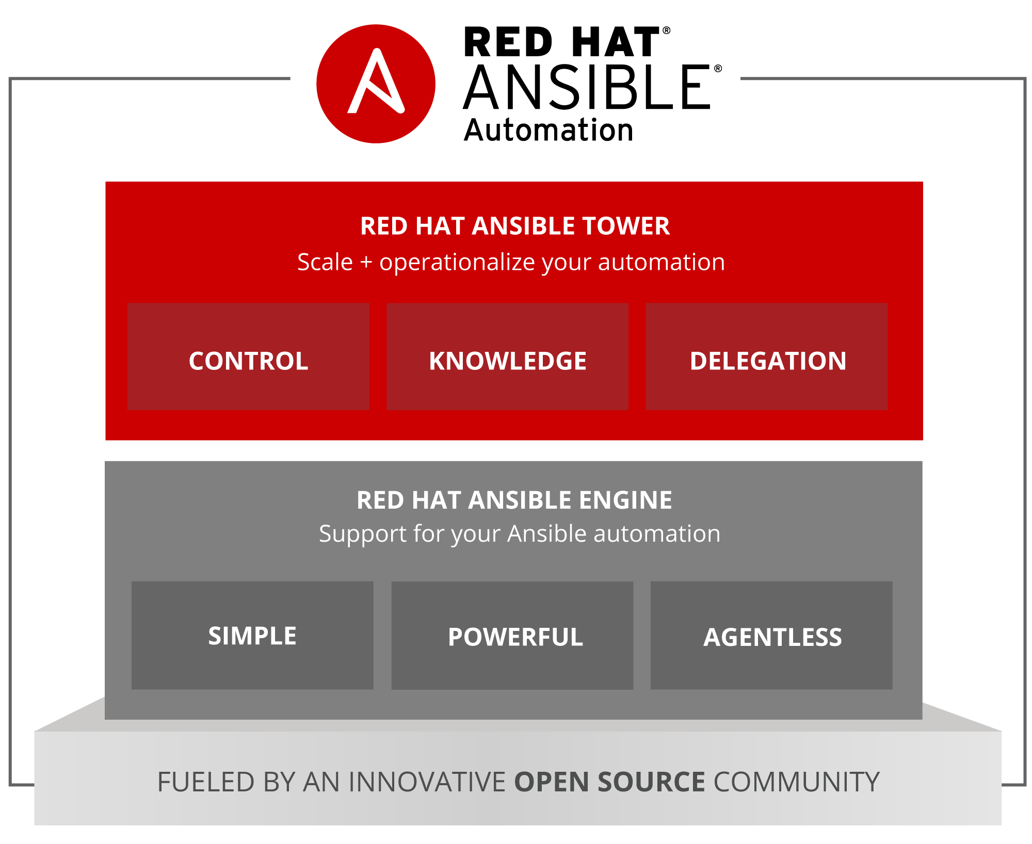

Slide 27
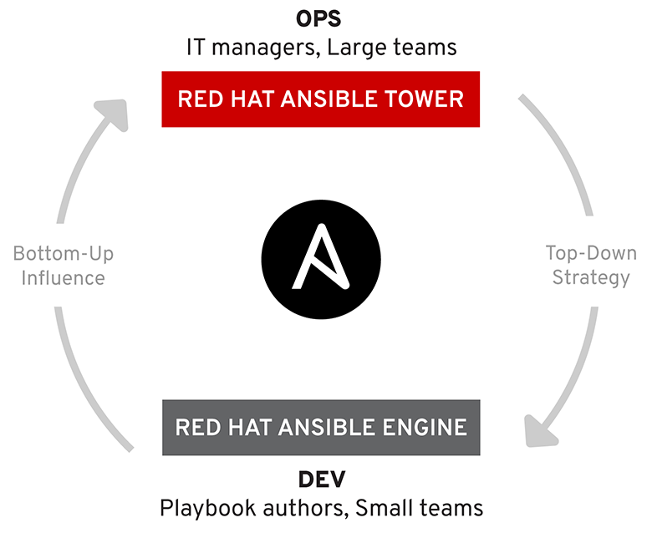

Slide 28
Red Hat Ansible
Fedora | RHEL
Ansible (source) | Red Hat Ansible Engine
AWX | Red Hat Ansible Tower

Slide 29
So THAT’s why Ansible

Slide 30
Live Demo

Slide 31
Deeper Dive

Slide 32
System Requirements
Control Machine Requirements
  Currently Ansible can be run from any machine with Python 2 (versions 2.6 or 2.7) or Python 3 (versions 3.5 and higher) installed (Windows isn’t supported for the control machine).
Managed Node Requirements
  On the managed nodes, you need a way to communicate, which is normally ssh. By default this uses sftp. If that’s not available, you can switch to scp in ansible.cfg. You also need Python 2.6 or later.
  Source: http://docs.ansible.com/ansible/latest/intro_installation.html#control-machine-requirements

Slide 33
Installing Ansible
Yum (CENTOS/RHEL)
Apt (Ubuntu/Debian)
Pip
$ sudo easy_install pip
$ sudo pip install ansible
If for any reason you have issues, try:
$ sudo -H pip install --ignore-installed --upgrade ansible

Slide 34
Running Ansible
$ ansible <device_list> -m <module> -a <attributes> -u <username> -k
$ ansible 10.1.1.1 -m raw -a "command" -u <user> -k
  FAILS.
  No inventory file. This is a minimum requirement.
So we need to create an inventory file.
Inventory files are plain text files which contain a list of devices which you intend to manage with Ansible. It can be as simple as a straight list of IP addresses. Inventory files can be formatted in different ways, but a common one is the Windows INI file format. The other common format is YAML, which is also the format used to write Ansible Playbooks.

Slide 35
Simple Inventory File
10.1.1.1
10.1.1.2
10.1.1.3
node1.domain.com
node2.domain.com
…
last.item.com

Slide 36
Inventory File
[routers:children]
backbone-routers
gateway-routers
[backbone-routers]
backbone1 ansible_host=10.1.1.1
backbone2 ansible_host=10.1.1.2
backbone3 ansible_host=10.1.1.3
[gateway-routers]
gateway1 ansible_host=10.1.2.1
gateway2 ansible_host=10.1.2.2
[switches]
switch1 ansible_host=10.1.3.1
switch2 ansible_host=10.1.3.2
switch3 ansible_host=10.1.3.3
10.1.4.1
10.1.5.1
Groups of Groups
Groups
Host variable

Slide 37
Running Ansible (2)
$ ansible <device_list> -m <module> -a <attributes> -u <username> -k
$ ansible 10.1.1.1 -i inventory.txt -m raw -a "command" -u <user> -k
  It WORKS! But this is a lot of typing.
Let’s create an ansible.cfg file to hold our default settings.

Slide 38
ansible.cfg
##################################################
# Default configuration values
##################################################
[defaults]
inventory = ./inventory.txt
host_key_checking = False ;Disable checking SSH keys on remote nodes
record_host_keys = False ;Disable recording newly discovered hosts in hostfile
timeout = 10 ;Specify how long to wait for responses
forks = 30 ;Number of parallel processes to spawn
ask_pass = True ;Playbooks should prompt for password by default
# ask_vault_pass = True
# The following is since we're dealing with Cisco IOS mostly
gathering = explicit ;facts not gathered unless directly requested in play
# log_path = ./ansible.log ;log information about executions
module_name = raw ;default module name (-m) value for /usr/bin/ansible
remote_user = frank_seesink
# vault_password_file = /path/to/vault_password_file
(Windows INI format)

Slide 39
ansible.cfg Locations
ANSIBLE_CONFIG
(an environment variable)
ansible.cfg (in the current directory)
.ansible.cfg (in the home directory)
/etc/ansible/ansible.cfg

Slide 40
Running Ansible (3)
$ ansible <device_list> -i <inventory> —m <module> -a <attributes> -u <username> -k
$ ansible 10.1.1.1 -a “command”
e.g.,
$ ansible 10.1.1.1 -a “show version”
$ ansible routers -a “show version”
$ ansible routers -a “show version” | grep “SUCCESS\|Version”
$ ansible switches -a “show run” | grep “SUCCESS\|username”
$ ansible all -a “show run | include ntp”| grep “SUCCESS\| ntp”

Slide 41
Example 1
(single file inventory)
~/
    ansible.cfg
    inventory.txt
    setup_router.yml
    vlan.yml

Slide 42
Example 2
(Using directories)
~/
    ansible.cfg
    group_vars/
        backbone-routers
        gateway-routers
        switches
    host_vars/
        backbone1
        backbone2
        …
        switch3
    inventory.txt
    setup_router.yml
    vlan.yml
———
ansible_host: 10.1.1.1
———
ansible_host: 10.1.1.2
———
ansible_host: 10.1.3.3

Slide 43
Ansible Playbooks
YAML files
Starting with Ansible v2.4
  Imperative (define each step) vs. Declarative (define end state)

Slide 44
Playbook (raw)
---
- name: Show version of IOS running on routers
hosts: routers
gather_facts: false
tasks:
- name: Use raw mode to show version
raw: "show version"
register: print_output
- debug: var=print_output.stdout_lines

Slide 45
Playbook (ios_command)
---
- name: Backup running-config on routers
hosts: routers
gather_facts: false
connection: local
tasks:
- name: Backup the current config
ios_command:
authorize: yes
commands: show run
register: print_output
- name: save output to a file
copy: content="{{ print_output.stdout[0] }}" dest="./output/{{ inventory_hostname }}.txt"

Slide 46
Playbook (ios_command)
---
- name: Show IOS version and interfaces on switches
hosts: switches
gather_facts: false
connection: local
tasks:
- name: Run multiple commands and evaluate the output
ios_command:
authorize: yes
commands:
- show version
- show interfaces
register: print_output
- debug: var=print_output.stdout

Slide 47
Playbook (ios_command)
---
- name: Execute 'show version' on device(s)
hosts: "{{ host }}”
gather_facts: false
connection: local
tasks:
- name: Run show version
ios_command:
authorize: yes
commands:
- show version
register: print_output
- debug: var=print_output.stdout
# ansible-playbook show-version.yml -e “host=newtarget(s)"
# ansible-playbook show-version.yml -e “host=routers”

Slide 48
Playbook (ios_config)
---
- name: Define a VLAN
hosts: "{{ host | default(‘switches') }}"
gather_facts: false
connection: local
tasks:
- name: Define VLAN
ios_config:
timeout: 60
authorize: yes
parents: "vlan {{ vlan }}”
lines: ”name {{ vlanname }}”
- name: List VLANs
ios_command:
commands: ”show vlan | include {{ vlan }}.*active”
register: print_output
- debug: var=print_output.stdout
# ansible-playbook set-vlan.yml -e “vlan=250 vlanname=My-new-VLAN”

Slide 49
Playbook (ios_facts)
---
- name: Collect facts on an IOS device
hosts: "{{ host | default(‘switches') }}"
gather_facts: false
connection: local
tasks:
- name: Collect facts
ios_facts:
# gather_subset: all
- debug:
msg:
- "Router {{ inventory_hostname }}"
- "Hostname: {{ ansible_net_hostname }}"
- "S/N: {{ ansible_net_serialnum }}"
- "OS version: {{ ansible_net_version }}"
when:
- ansible_net_model | regex_search(‘3945')

Slide 50
Precedence
In 2.x, we have made the order of precedence more specific (with the last listed variables winning prioritization):
role defaults [1]
inventory file or script group vars [2]
inventory group_vars/all
playbook group_vars/all
inventory group_vars/*
playbook group_vars/*
inventory file or script host vars [2]
inventory host_vars/*
playbook host_vars/*
host facts
play vars
play vars_prompt
play vars_files
role vars (defined in role/vars/main.yml)
block vars (only for tasks in block)
task vars (only for the task)
role (and include_role) params
include params
include_vars
set_facts / registered vars
extra vars (always win precedence)
Source: http://docs.ansible.com/ansible/latest/playbooks_variables.html#variable-precedence-where-should-i-put-a-variable

Slide 51
Learning Materials
https://www.ansible.com/
  https://docs.ansible.com/
  https://www.ansible.com/webinars-training
https://www.udemy.com/ansible-for-network-engineers-cisco-quick-start-gns3-ansible/

Slide 52
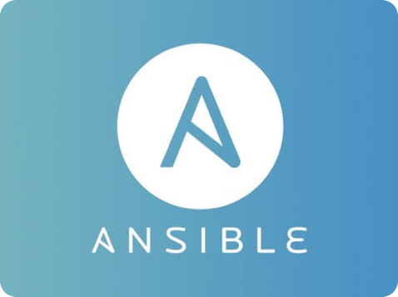
Questions?
http://frank.seesink.com
http://frank.seesink.com/presentations/Ansible-Fall2017

